Slide 1

Why Open Science
Slow, wasteful, locked away
Ruled by commercial interests
Reproducibility crises
Questionable research practices
Closed science means people suffer
Science is not working as it should be
@OpenScienceMOOC

Slide 2
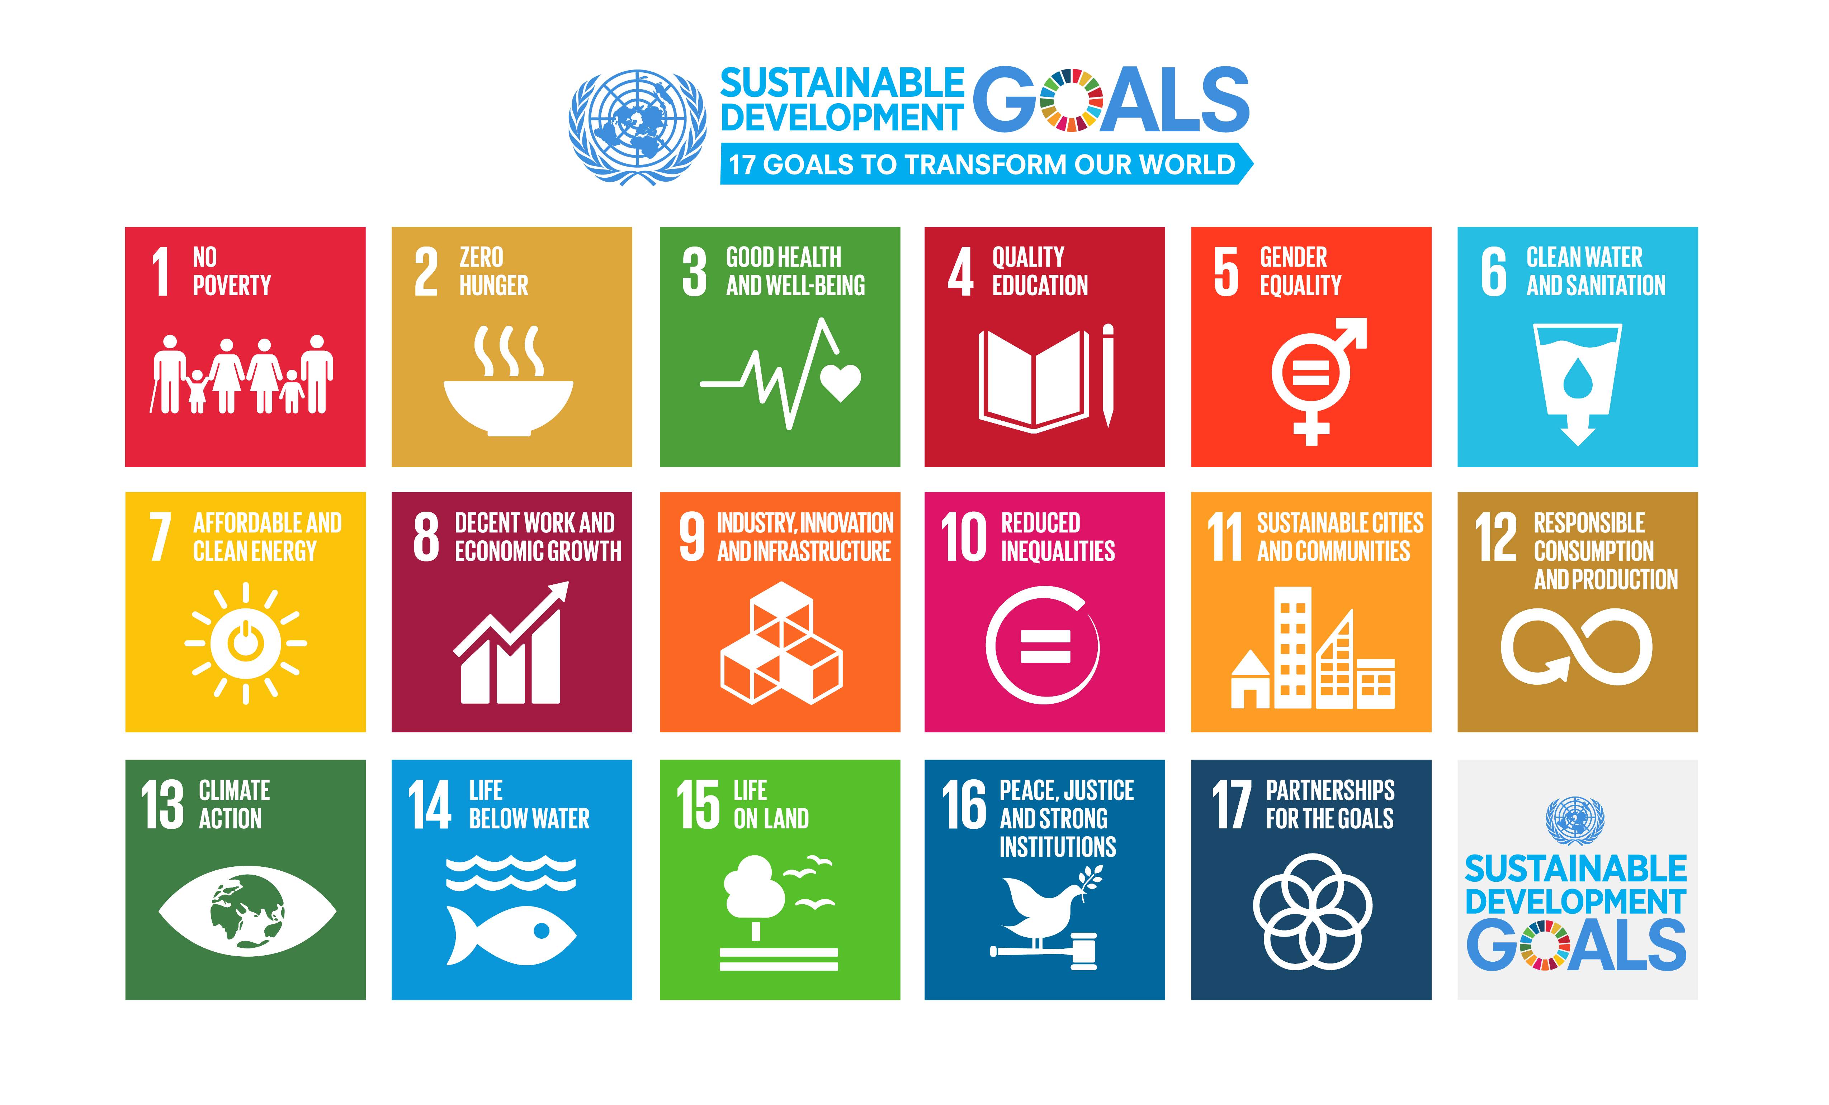
We need science if we are going to help quickly and sustainably solve these

Slide 3
Our vision of the future
To help make ‘Open’ the default setting for all global research.
We want to help create a welcoming and supporting community, with good tools, teachers, and role-models, and built upon a solid values-based foundation of freedom and equitable access to research.
@OpenScienceMOOC

Slide 4
The way we do research has changed for good
We now have new expectations
Transparency
Not secrecy
Collaborative
Not solo
Continuous
Not discretised
@OpenScienceMOOC

Slide 5
We should be training ourselves
Sustained community engagement across disciplines
Being active both politically and at a community level
Rethinking our mindset
Changing the incentive system
@OpenScienceMOOC

Slide 6
How do we get to where we want?
Imagine a future defined by the values of Open Science:
Freely available public good
Rigorous and reproducible
Open to ALL
Isn’t that just GOOD science?
@OpenScienceMOOC

Slide 7
The best researchers have already reinvented themselves into Openness
We need everyone to be collaborating together if we are going to help solve the challenges humanity faces.
#OpenScience
@OpenScienceMOOC

Slide 8
How do we fit in?
Community
Common values
Collaboration not competition
@OpenScienceMOOC

Slide 9
Introducing the Open Science MOOC
A peer-to-peer value-based community that works towards better science for society
@OpenScienceMOOC

Slide 10
What do researchers care about?
Saving time and effort
Problem solving
Advancing research We give them the knowledge and skills to do this
@OpenScienceMOOC

Slide 11
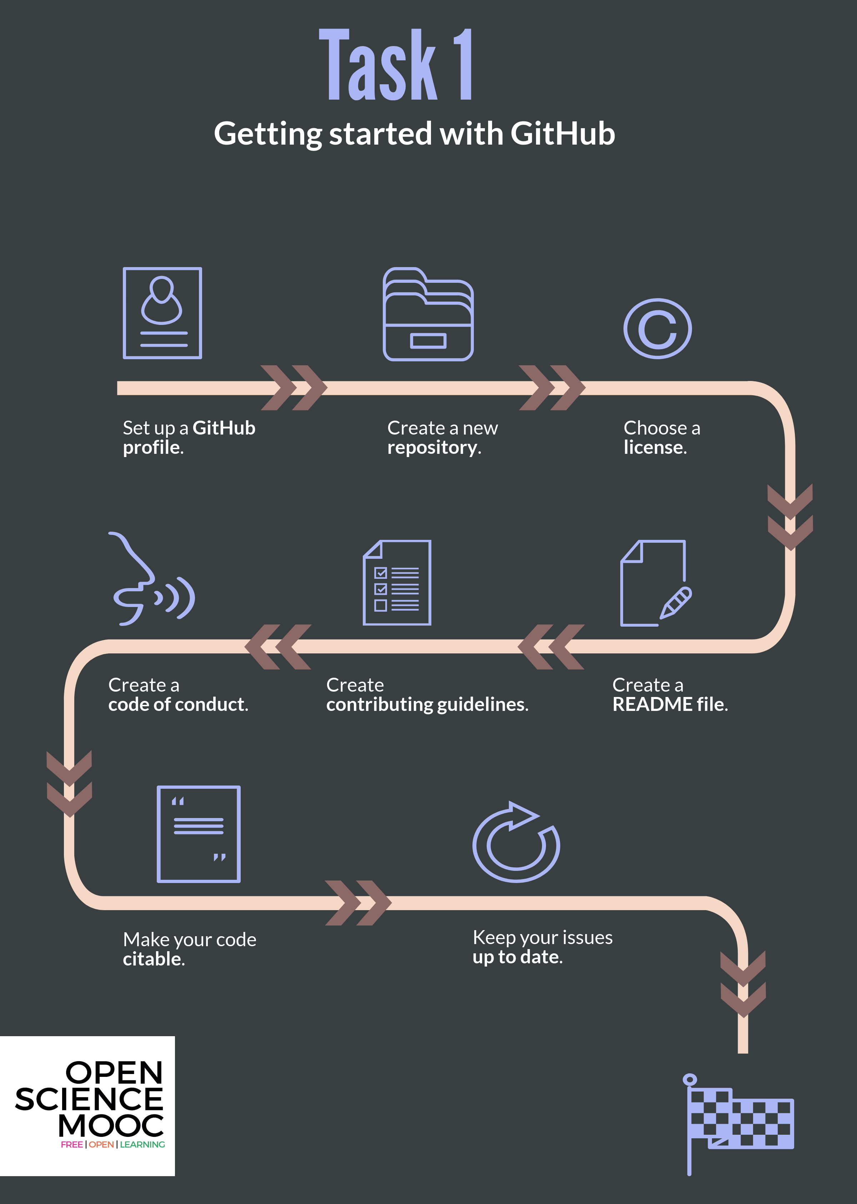
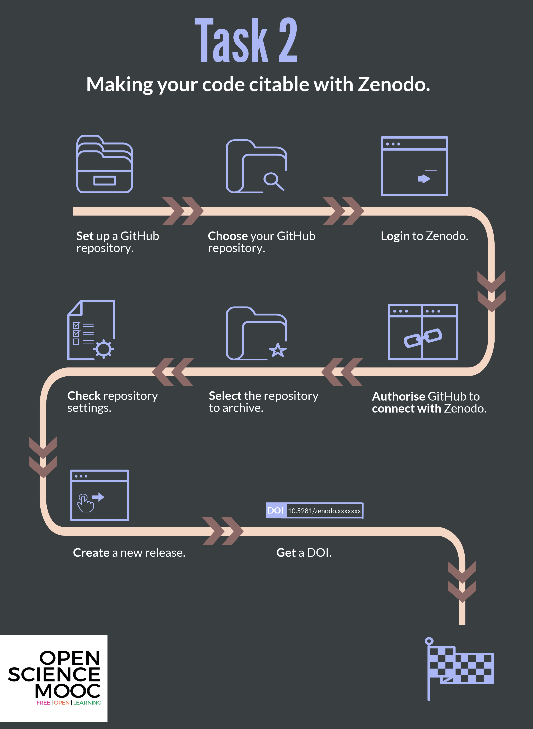

Slide 12

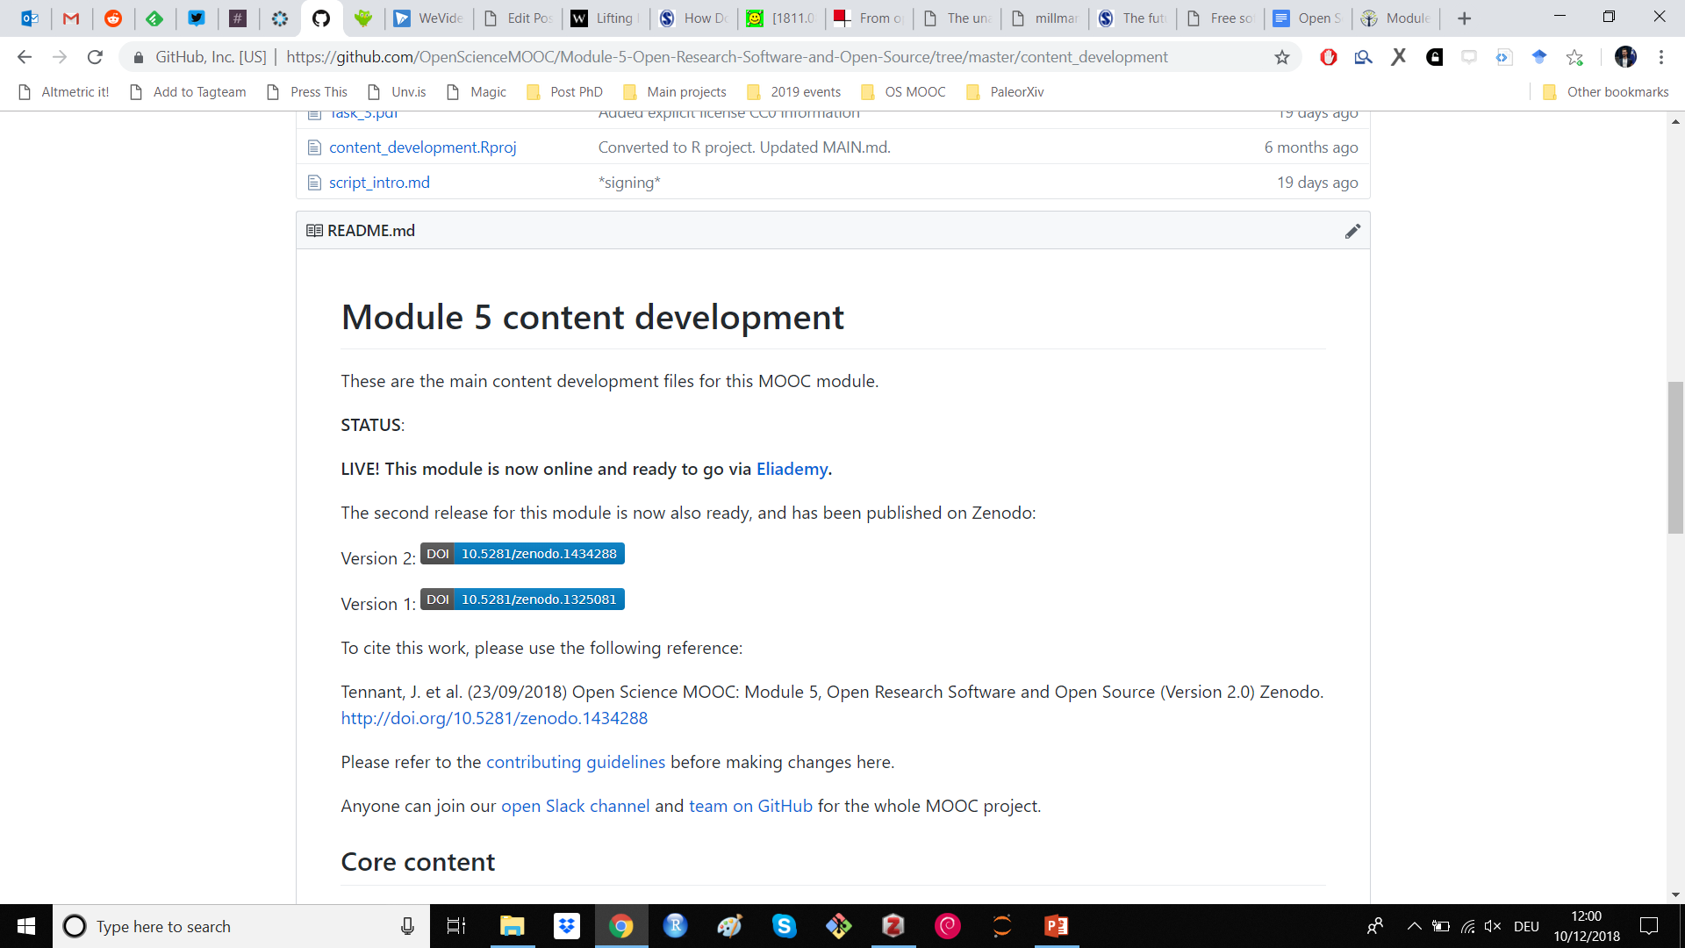
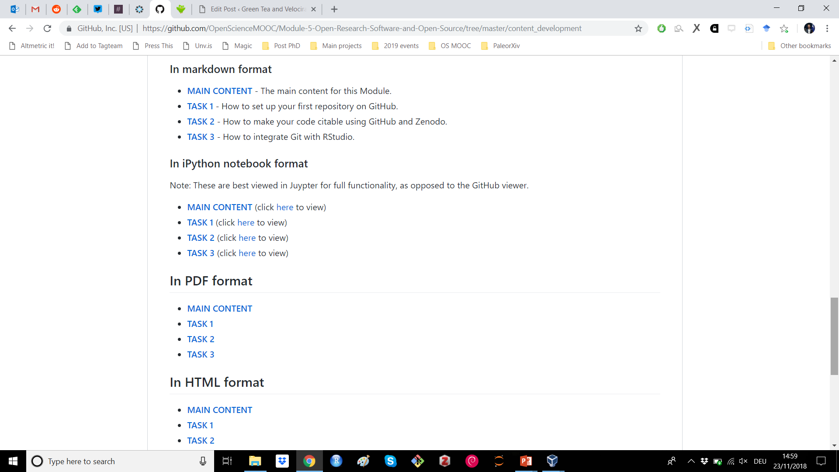
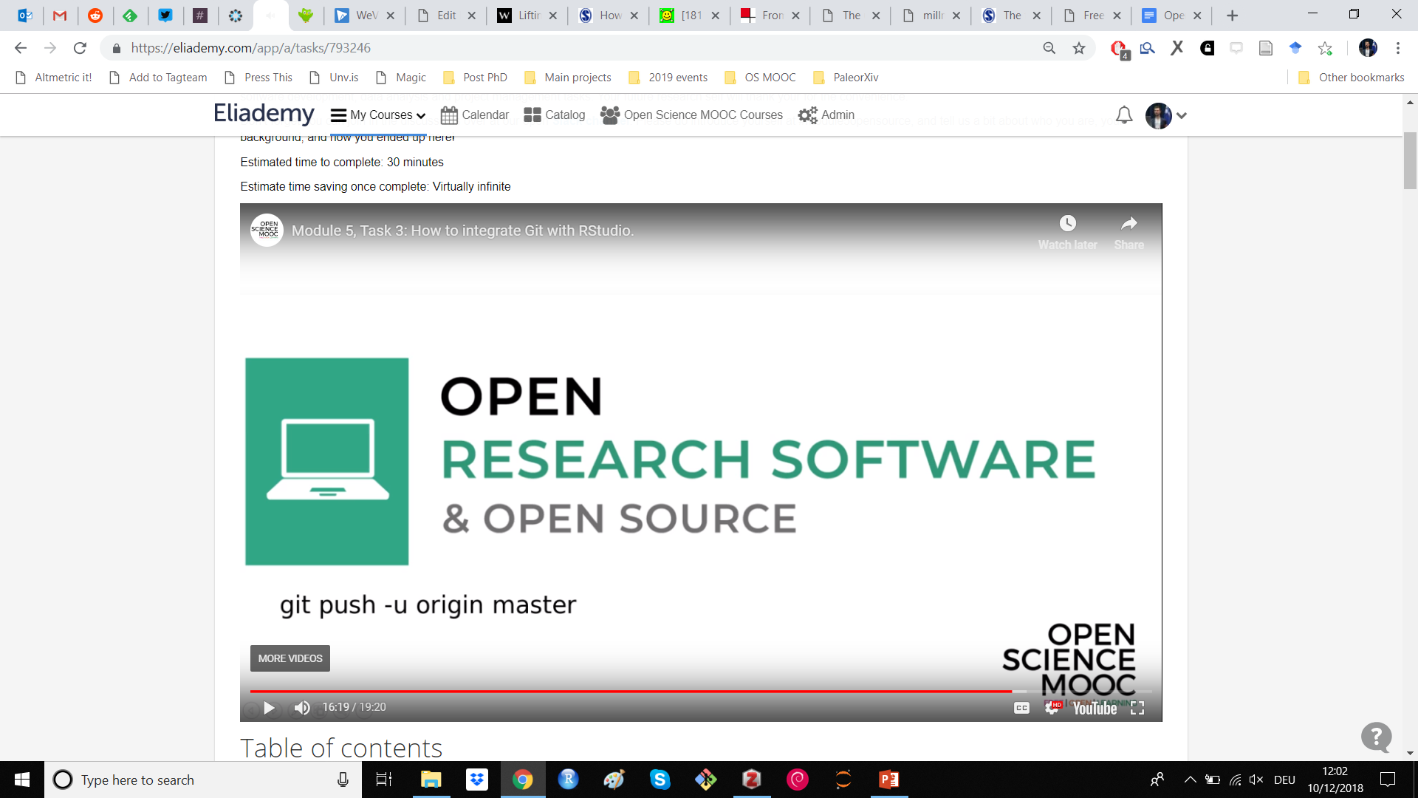
Open for re-use

Slide 13
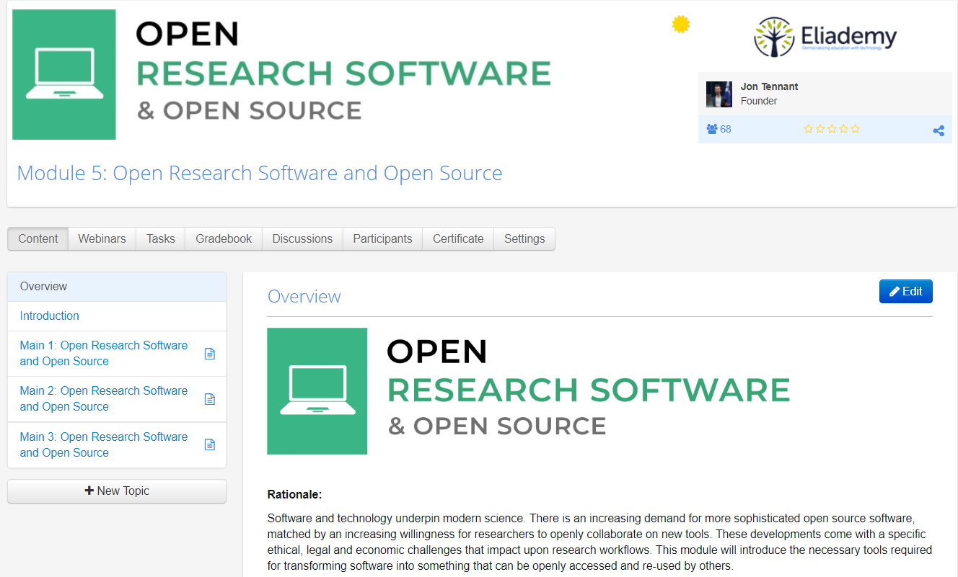
https://eliademy.com/catalog/oer/module-5-open-research-software-and-open-source.html

Slide 14
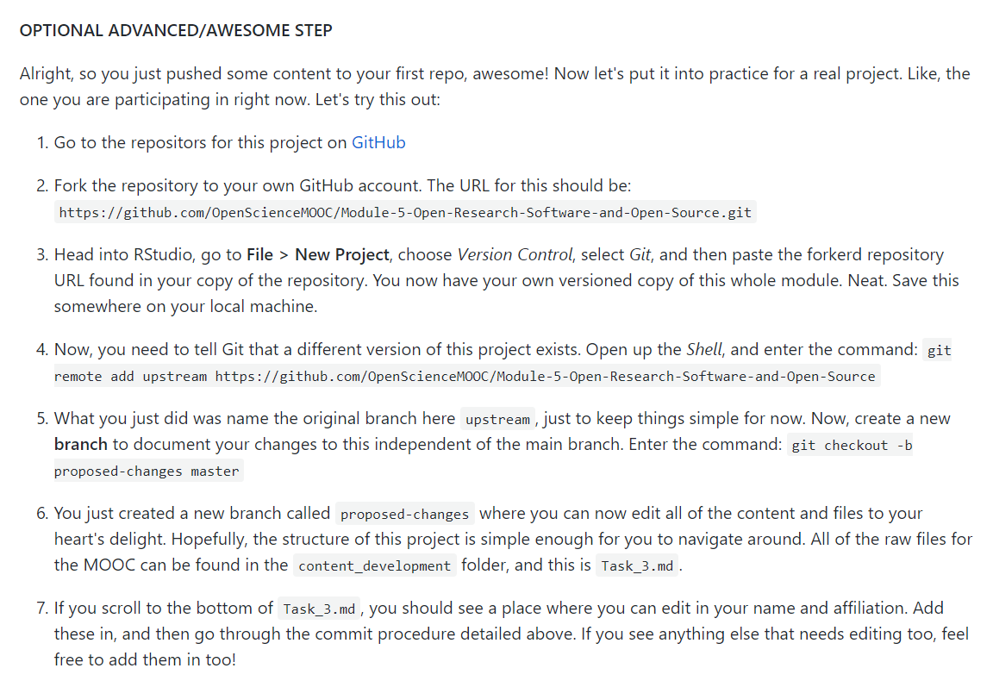
A fully interactive learning style
This allows learners to actually edit the MOOC content for this module. Nice.
Learning is based on participation and collaboration.

Slide 15
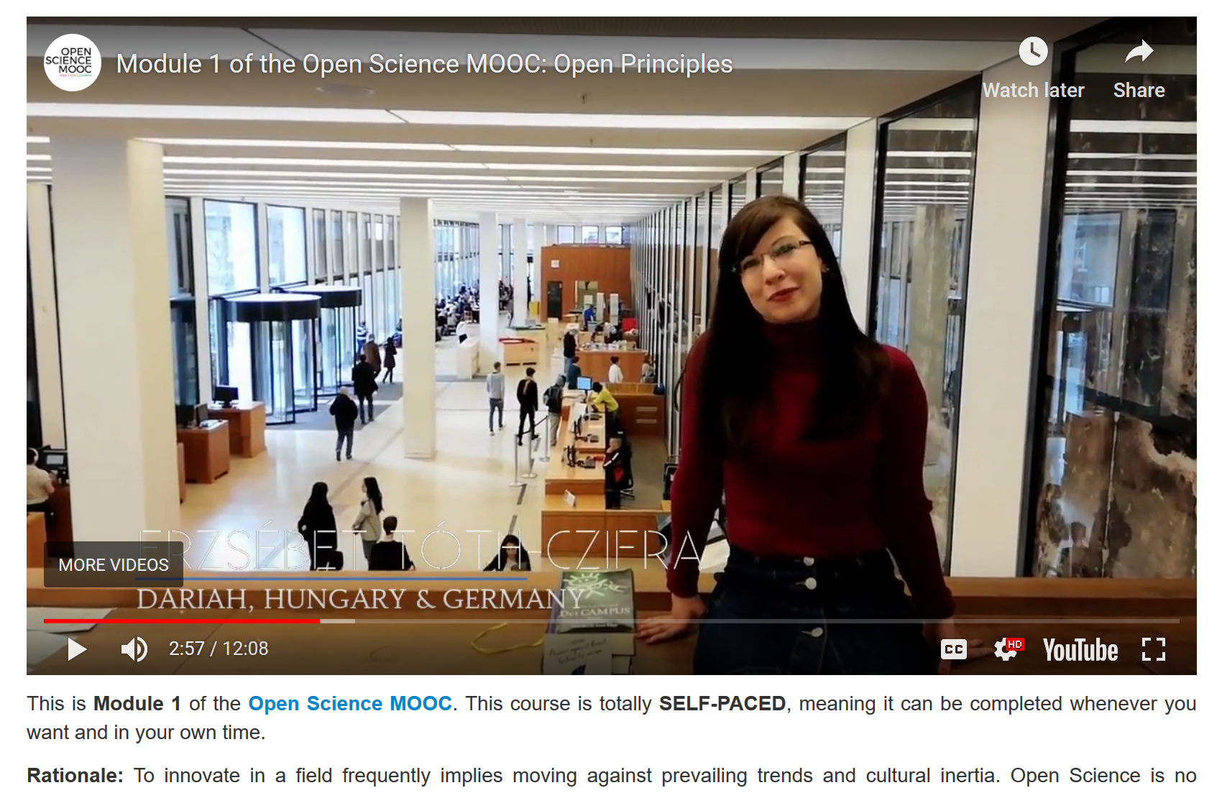
Way more than just an online course
We want to build more than a tool, a platform or a service.
We are committed to build an open and inclusive community!
Go check out our Module 1 on Open Principles, starring real #OpenScience heroes
https://eliademy.com/catalog/oer/module-1-open-principles.html

Slide 16
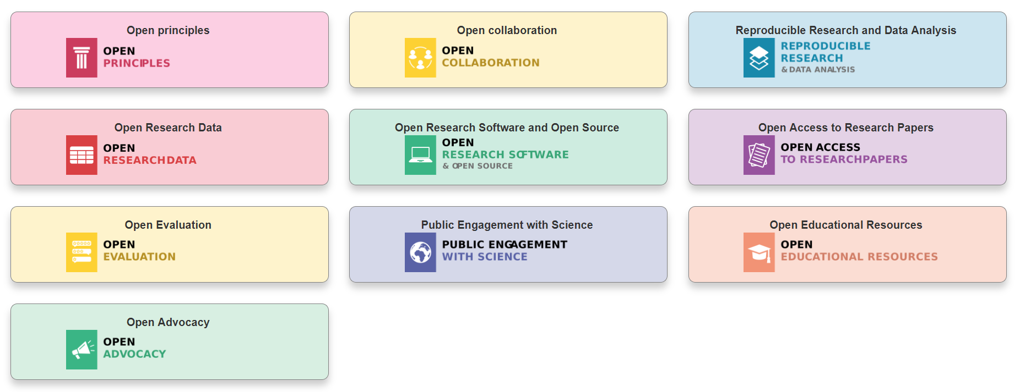
Modular learning
@OpenScienceMOOC
Designed by: Mike Morrison

Slide 17
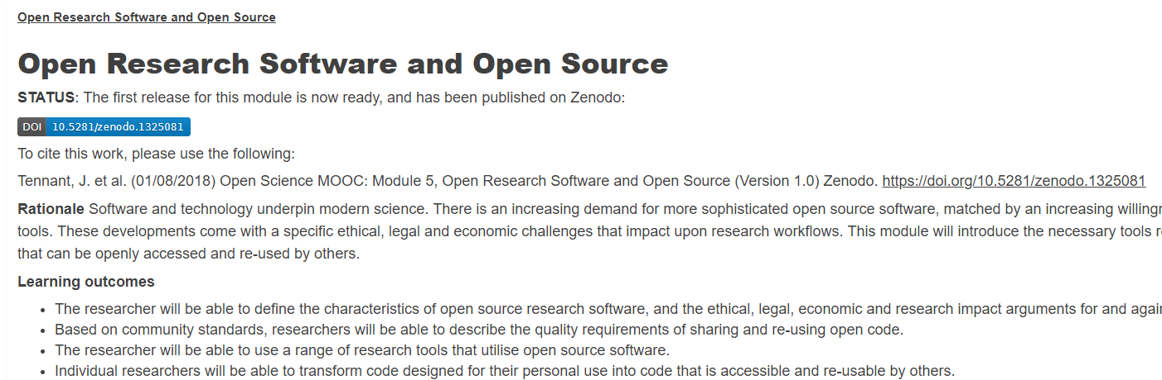

Open for re-use

Slide 18
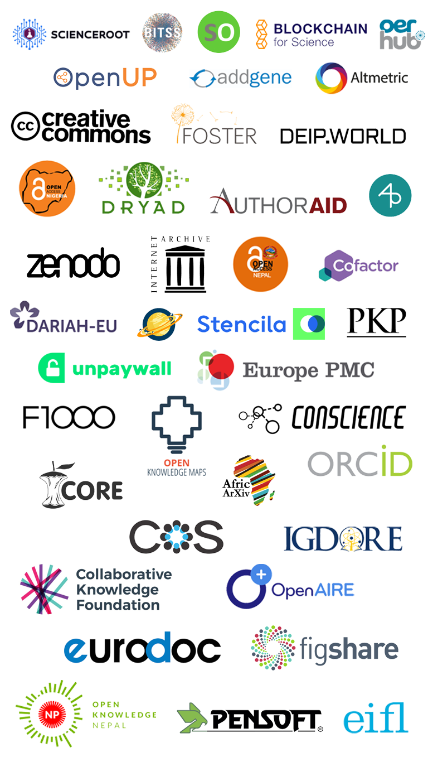
We are not alone

Slide 19
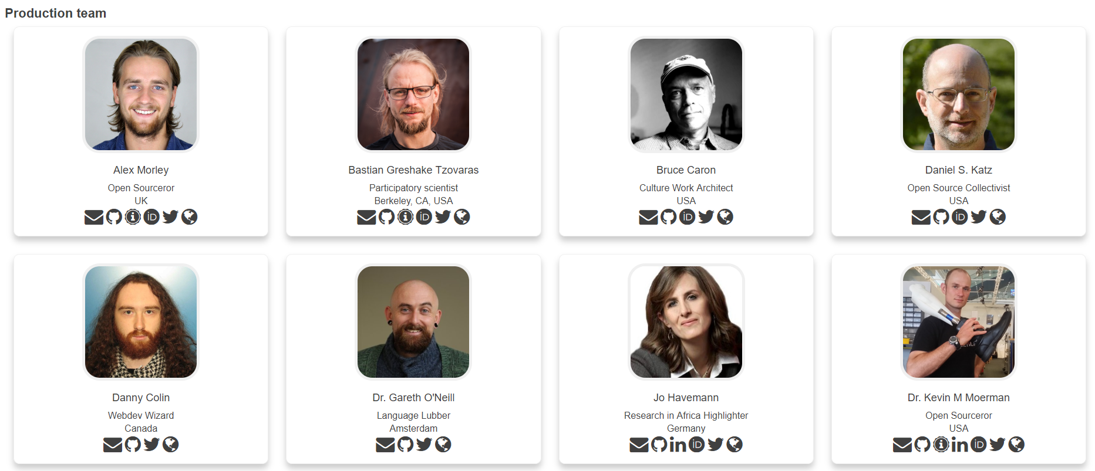
Some of our Production Team

Slide 20
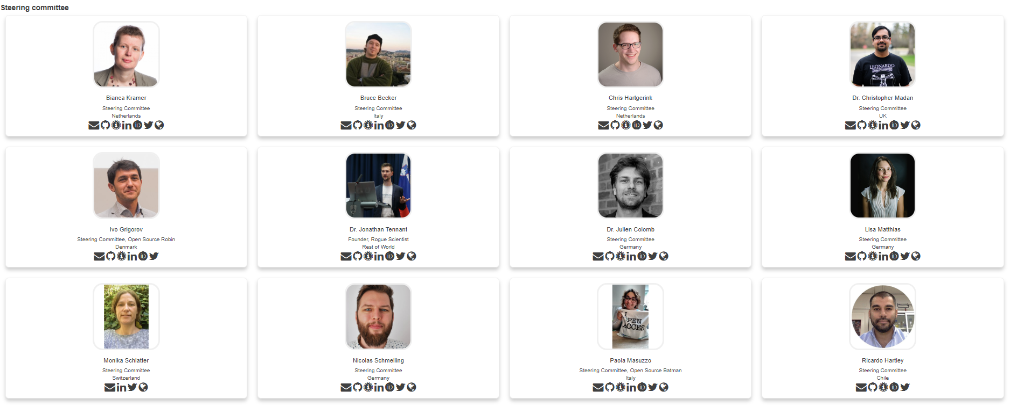
We are guided by passion

Slide 21
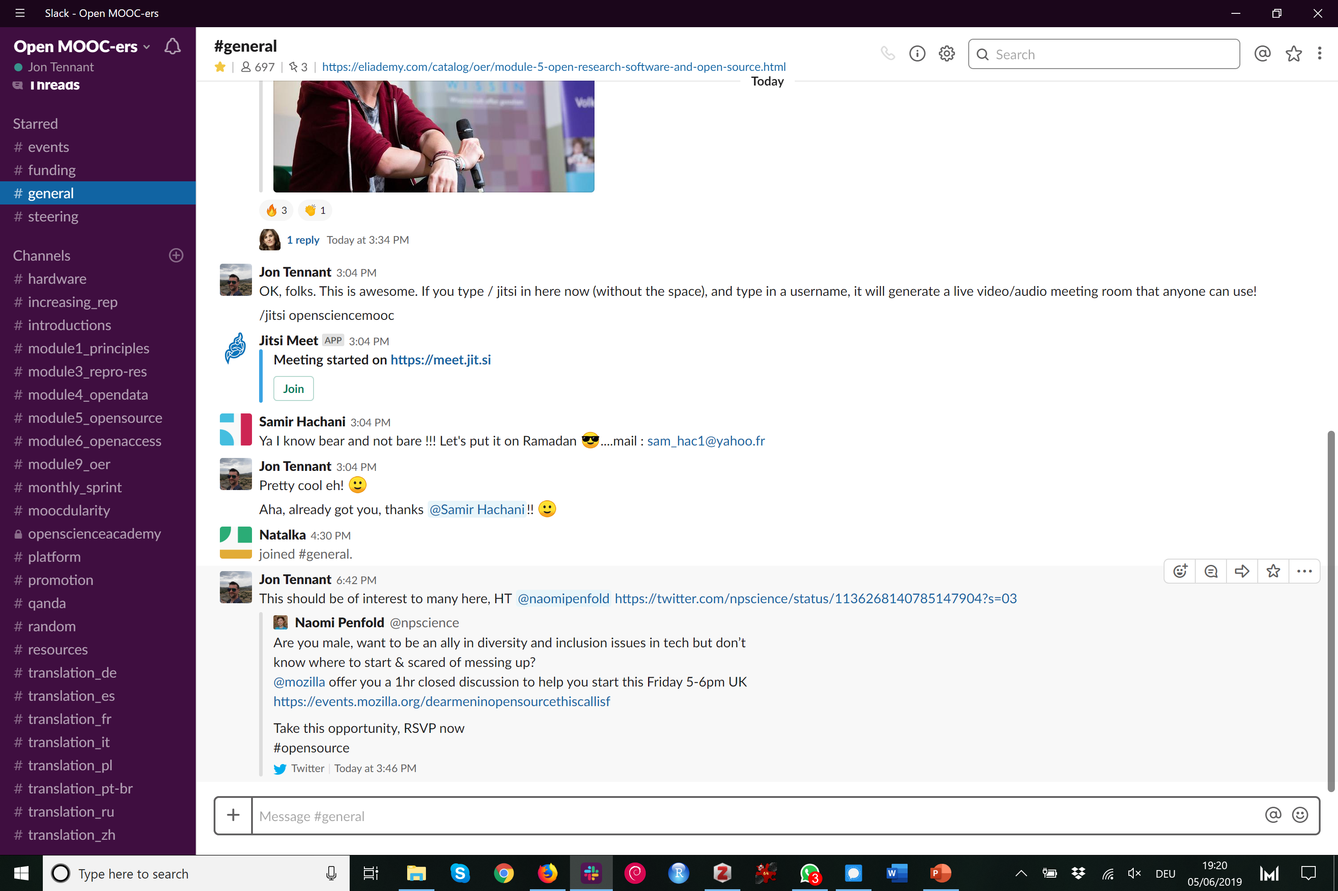
https://osmooc.herokuapp.com/

Slide 22
Skeptical? You should be.
@OpenScienceMOOC
But it’s not as new as you think.
Science was founded on openness.
We closed it down.
It’s time to open it up again.

Slide 23
Status
@OpenScienceMOOC
In development
700 Slack community members
6500 Twitter followers
45 strategic partnerships
650 people enrolled in Module 5 and 150 in Module 1
Agile development so people are already using content
Iterative feedback is our design

Slide 24
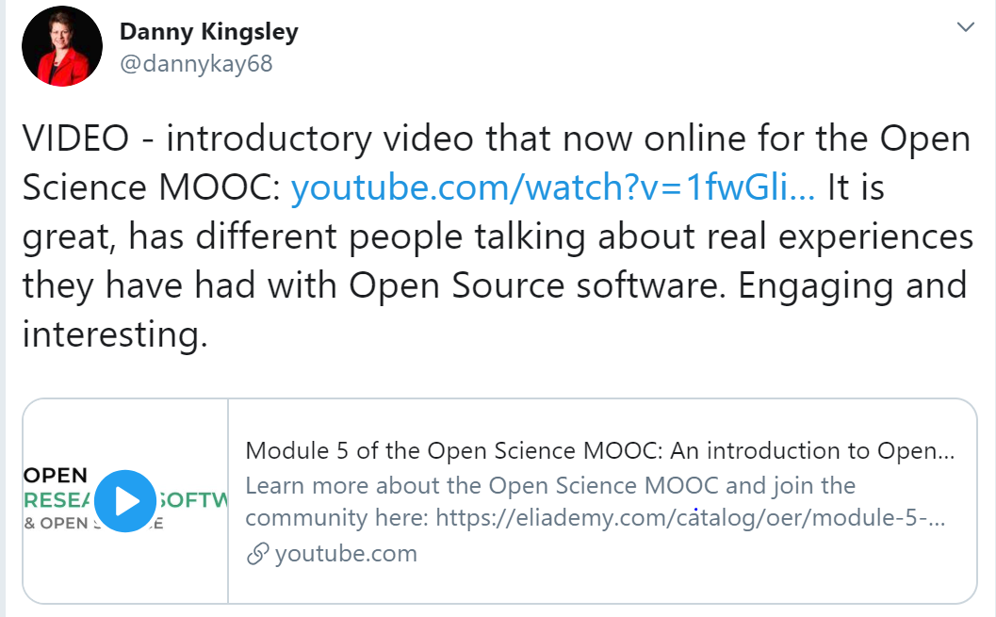
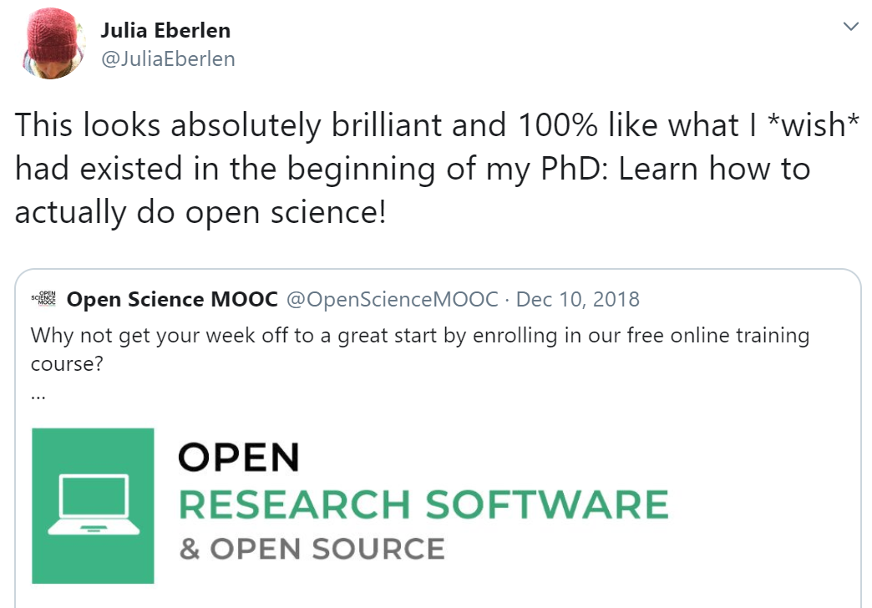
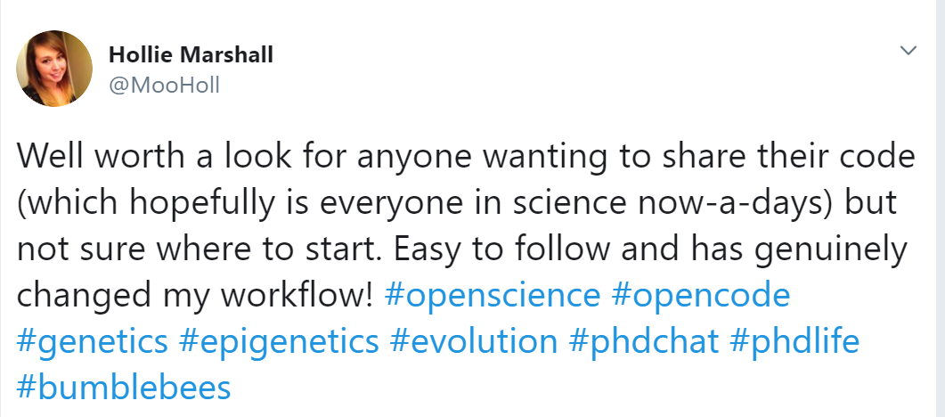
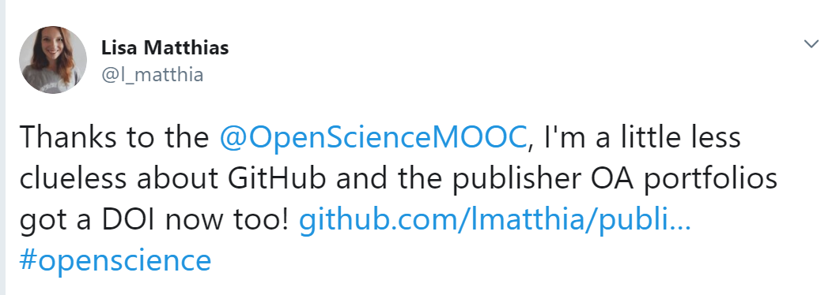
What people say of the MOOC

Slide 25
How do you want to shape your identity as a scientist?
Researchers can be world-changing heroes
We will give them the power to achieve that
@OpenScienceMOOC

Slide 26
Help science work for society again
People not profits!
Students, teachers, journalists, bloggers, startups, entrepreneurs, policymakers, citizen scientists, NGOs, charities, health practitioners.
We are here for you.
@OpenScienceMOOC

Slide 27

The end
Melanie Imming, & Jon Tennant. (2018, June 8). Sticker open science: just science done right.
Zenodo. https://zenodo.org/record/1285575

Slide 28
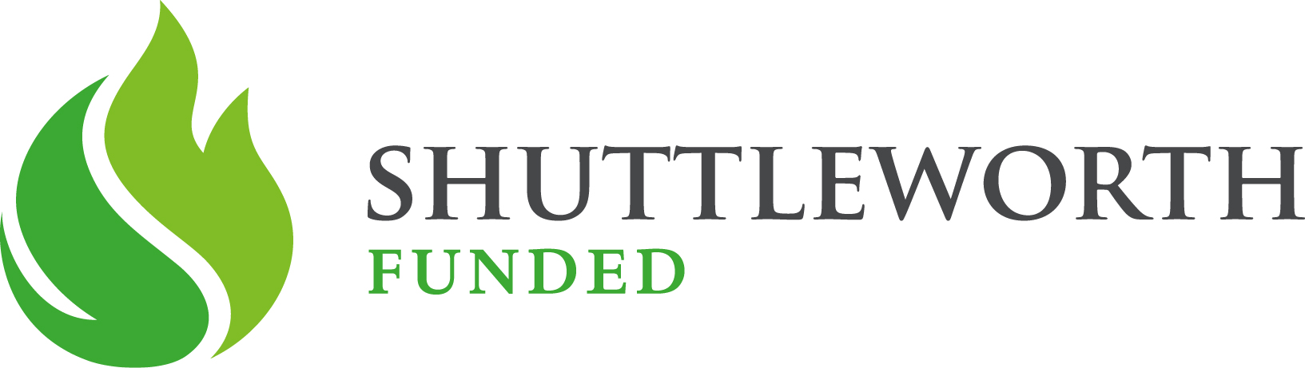
Thanks!
GitHub: https://github.com/OpenScienceMOOC
Website: https://opensciencemooc.eu
Twitter: @OpenScienceMOOC
Email: info@opensciencemooc.eu

